Slide 1

SIDDHARTH INSTITUTE OF ENGINEERING & TECHNOLOGY (AUTONOMOUS)
DEPARTMENT OF ELECTRONICS AND COMMUNICATION ENGINEERING
SECTION NO- 1
BATCH NO - 11
Authentication of ATM PIN by Random Word Generator Using Design Think Frame Work
TEAM MEMBERS:
P GOWTHAMI -20F61A0442
A B AJAY KUMAR -21F65A0401
C AJAY -20F61A0402
B JOSHI -21F65A0406
K HARISH -20F61A0450
Under the Esteemed guidance of :
B. Ravi Babu ,MTech
Assoc.Professor

Slide 2
Abstract
The main aim of this system he proposed system presents a multi-layered security approach for access control. It initiates with RFID-based authentication, where the user's RFID card is scanned, prompting the system to generate a unique one-time password (OTP). This OTP is then dispatched to the user via GSM technology. Upon receipt of the OTP, the user must input it using a Bluetooth-enabled device, such as a smartphone or tablet. This additional verification layer guarantees that only authorized personnel can proceed further. If the entered OTP matches the one sent, the security door automatically unlocks, granting access. Conversely, an incorrect OTP entry triggers a buzzer alert, effectively thwarting any unauthorized entry attempts. This integrated system seamlessly combines RFID technology, GSM communication, Bluetooth verification, and a robust security door mechanism to establish a secure and user-friendly access control solution, offering enhanced security for various applications.

Slide 3
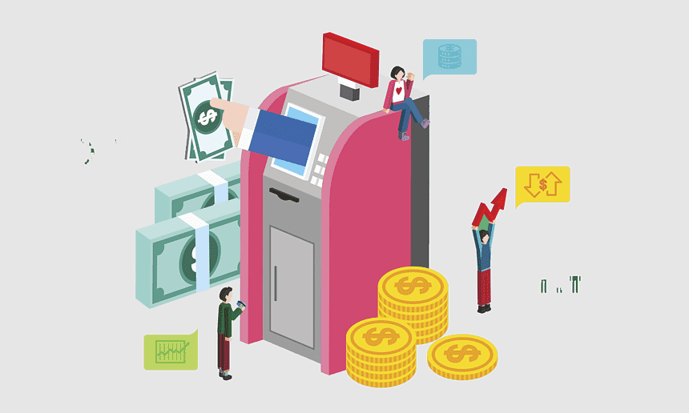
Introduction
Money can be deposited and withdrawn from an ATM. A card is inserted into an ATM processor, which is an automatic teller machine that exchanges money for the card. ATMs come in two different varieties. To dump money by the user and receive a receipt based on the account is the first type. The second kind is more sophisticated; it allows for credit card payments, cash deposits, and account information retrieval. Several people utilize ATMs to deposit cash. In order to make it simple to remember, an ATM machine that is close to the user's location can be used to obtain cash if that is what they need. According to user needs, an ATM machine has two inputs and four outputs. Each ATM card has a distinct number, known as a PIN number.

Slide 4
Motivation
Security
Introducing a random word generator for ATM PINs strengthens security against various threats by creating complex, difficult-to-guess combinations, enhancing ATM transaction security.
User experience
Memorizing a random word might be more intuitive and easier for users compared to remembering a sequence of numbers. This could potentially reduce instances of forgotten PINs and the need for users to write them down, which can be a security risk in itself.
innovation
Introducing a random word generator for ATM PINs represents an innovative approach to addressing security concerns. It demonstrates a willingness to think outside the box and explore unconventional solutions to traditional problems.

Slide 5
LITERATURE SURVEY:
S.NO | Author | Title | Problem | Summary/observation
1 | A. Manikandan | This survey from 2018 explores IoT security, covering vulnerabilities, countermeasures, and future directions. | Security vulnerabilities in IoT systems | Analyzes common security vulnerabilities in IoT systems, including those relevant to ATMs, and proposes countermeasures.
2 | J. Zhang | This 2019 study explores improving user authentication through random words and facial recognition. | User experience and security trade-offs in traditional PIN-based authentication | Studying using random words and facial recognition for logging in, showing how it could be easier and safer than just using PINs.
3 | S. Choi | Applying Design Thinking to Develop a User-Centered ATM Interface (2020) | Traditional ATM interfaces lack user-friendliness and accessibility. | Using design thinking to craft an ATM interface that's user-centric and accessible, focusing on meeting user needs and preferences as a top priority.
4 | M. Hassan | An Innovative Design of a Secure and User-Friendly ATM System (2019) | Security and user experience limitations of existing ATM systems | Investigating RFID technology to make ATMs safer with an extra layer of security.

Slide 6
S.no | Author | Title | Problem | Summary/observation
5 | L. Wang | Research on the Application of RFID Technology in ATM Security (2017) | Security vulnerabilities related to physical access to ATMs | Investigating RFID technology to make ATMs safer with an extra layer of security.
6 | A. Sadeghi | Security and Privacy in Cyber-Physical Systems: Foundations, Challenges, and Future Directions (2015) | Security and privacy challenges in cyber-physical systems, including ATMs | Addressing the distinct security and privacy challenges of cyber-physical systems such as ATMs, emphasizing the necessity for robust security solutions.
7 | Smith, J | Enhancing ATM Security: A Random Word Generator Approach" | Traditional ATM PINs vulnerabilities | Introducing a new way to log into ATMs with random words, making it easier and safer with thoughtful design.
8 | David Williams | Usability Evaluation of Random Word Generated ATM PINs | Forgettable and easily guessable traditional ATM PINs | Assesses how well random word-generated PINs work in ATM systems by testing with users. Shows how this method balances security and usability.

Slide 7
S.NO | Author | Title | Problem | Summary/observation
9 | A. Alshawi | Improving ATM Security using Two-Factor Authentication and Biometric Recognition (2018) | Traditional PIN-based authentication poses security risks, while IoT-related privacy and trust issues are critical considerations for ATM security. | Proposes a two-factor authentication system for ATMs utilizing biometric recognition alongside PINs for enhanced security.
10 | T. Dimitrious | A Survey on Attacks Against ATMs (2016) | Comprehensive overview of various attack vectors against ATMs | Explores various ATM attack methods like skimming, cash trapping, and malware injection, offering insights for enhancing security measures.
11 | E. Bertino | Data Security and Privacy in Cloud Computing (2013) | Security and privacy concerns in cloud-based systems | Discusses security and privacy challenges in cloud-based systems relevant to storing and managing ATM transaction data in the cloud.

Slide 8
S.no | Author | Title | Problem | Summary/observation
13 | M. Conti | Why Traditional PINs are No Longer Secure (2018) | Vulnerability of PIN-based authentication to various attacks | Argues that traditional PINs are no longer sufficiently secure due to advances in technology and social engineering attacks, highlighting the need for alternative authentication methods.
14 | D. Querzola | Applying Design Thinking Methodology to Improve ATM User Experience (2020) | Lack of user-centered design in traditional ATM interfaces | Demonstrates the application of design thinking to improve the user experience of ATMs, focusing on usability and accessibility considerations.
15 | N. Kumar | A Comprehensive Survey on Biometric Authentication Techniques (2020) | Overview of various biometric authentication methods | Provides a comprehensive overview of different biometric authentication technologies like fingerprint, facial recognition, and iris recognition, which could be considered for ATMs.

Slide 9
Existing method
Authentication based on passwords is used largely in applications for computer security and privacy. However, human actions such as choosing bad passwords and inputting passwords in an insecure way are regarded as “the weakest link” in the authentication chain. Rather than arbitrary alphanumeric strings, users tend to choose passwords either short or meaningful for easy memorization. With web applications and mobile apps piling up, people can access these applications anytime and anywhere with various devices. This evolution brings great convenience but also increases the probability of exposing passwords to shoulder surfing attacks. Attackers can observe directly or use external recording devices to collect users’ credentials. To overcome this problem, we proposed a novel authentication system

Slide 10
Proposed System
The proposed system project incorporates a multi-step security process. It begins with an RFID-based authentication, where the user's RFID card is read, triggering the system to generate a one-time password (OTP). This OTP is then transmitted to the user via GSM (Global System for Mobile Communications).
Upon receiving the OTP, the user is required to enter it through a Bluetooth-enabled device, such as a smartphone or tablet. This additional layer of verification ensures that only authorized individuals can proceed.
If the entered OTP matches the one sent, the security door unlocks, allowing access. However, in cases of an incorrect OTP entry, a buzzer alert is activated, denying unauthorized entry attempts.
This comprehensive system combines RFID technology, GSM communication, Bluetooth verification, and a security door mechanism to provide robust security measures while ensuring user convenience and access control.

Slide 11
Block Diagram/Circuit Diagram
Power Supply
RFID tag
Arduino UNO
L293D
Motor
RFID reader
LCD
Bluetooth
Buzzer
GSM

Slide 12
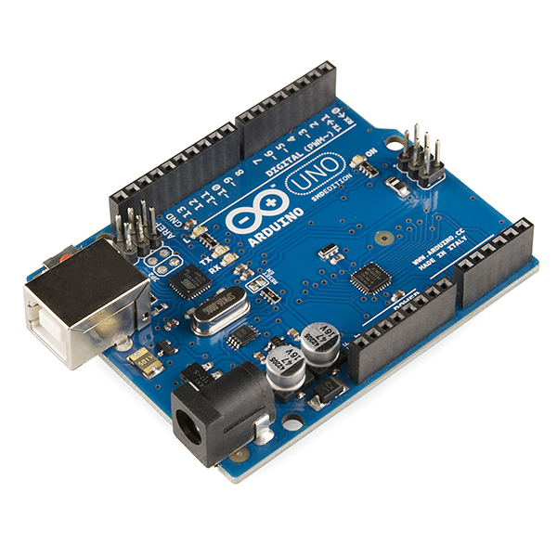
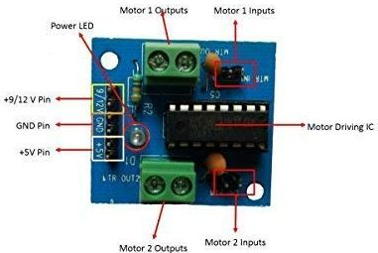
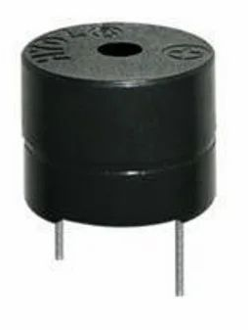
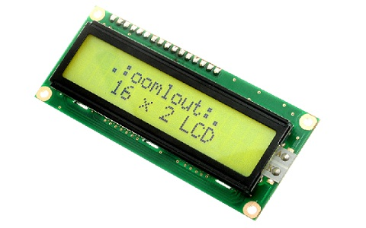
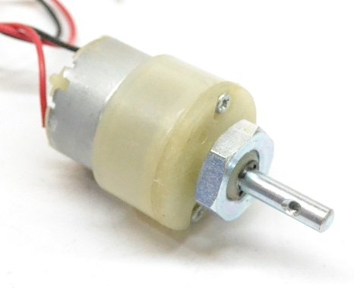
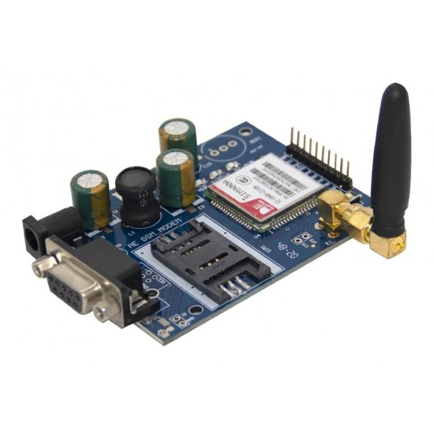
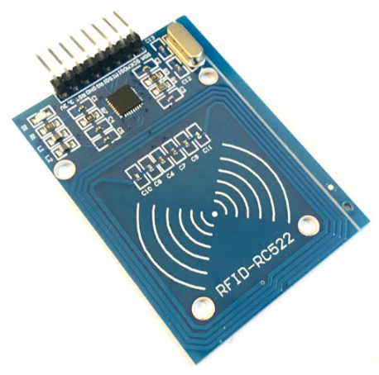
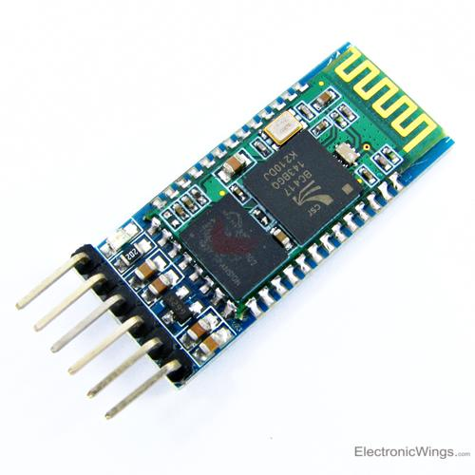
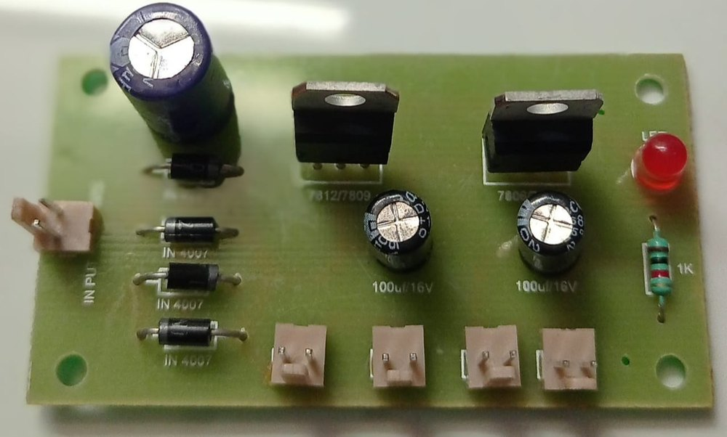
Hardware Details
Arduino Motor Driver LCD Dc Motor Buzzer
GSM power Supply RFID Module Bluetooth

Slide 13
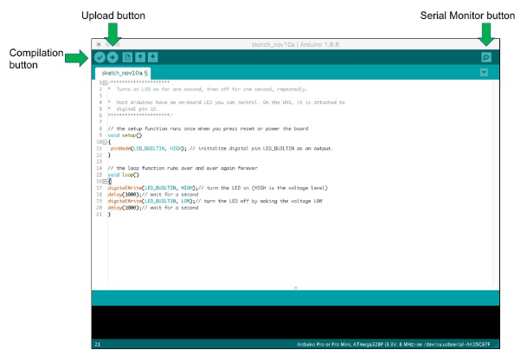
Software Details
Arduino IDE
The Arduino IDE (Integrated Development Environment) is used to write the computer code and upload this code to the physical board. The Arduino IDE is very simple and this simplicity is probably one of the main reason Arduino became so popular. We can certainly state that being compatible with the Arduino IDE is now one of the main requirements for a new microcontroller board.

Slide 14
Applications & Advantages
Applications:
Banking and Finance
Access Control
Government Services
Smart Home
Advantages:
Enhanced Security
Reduced PIN Memorization
Reduced Fraud
Dynamic and Adaptive

Slide 15
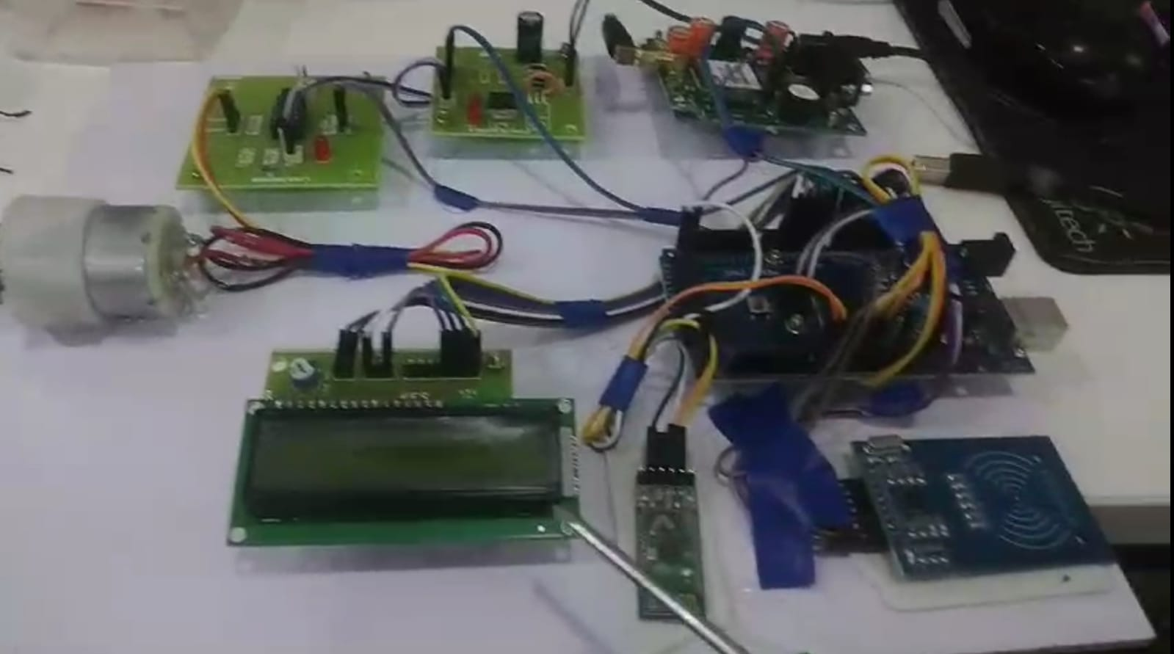
Expected Output
Overall strong security can be developed by using proposed method of rand word generation. So it helps us to overcome the main drawbacks of misusing highly authenticated security of like fingerprint and to reduce the use of skimmer.

Slide 16
References
[1] Ms.Ojaswi K. Kasat, Dr.Umesh S. Bhadade, “Revolving Flywheel PIN Entry Method to Prevent Shoulder Surfing Attacks”, 3rd International Conference for Convergence in Technology (I2CT), pp.1-5, Apr 06-08, 2018 .
[2] Priyadarshini, Mrs.R.Kurinjimalar, “security enhancement in automated teller machine”, International Conference on Intelligent Computing and Control(I2C2),2017
[3] Apurva Taralekar, GopalsinghChouhan, RutujaTangade, Nikhilkumar Shardoor, “One Touch Multi-banking Transaction ATM System using Biometric and GSM Authentication”, International Conference on Big Data, IoT and Data Science (BID) ,Vishwakarma Institute of Technology, Pune, pp.61-68, Dec 20-22,2017 .

Slide 17


